Slide 1
Front End Engineering-I Project
Team Details:
RAGHAV KAKKAR(2210990698)
RACHIT WALIA(2210990695)
RAGHAV DUA(2210990697)
RAGHAV BALUNI(2210990696)
Faculty Coordinator:
VIKAS PATEL
:
Chitkara University Institute of Engineering and Technology,
Chitkara University, Punjab

Slide 2
Table of Contents
Introduction
Problem Statement
Technical Details
Key Features
Project Highlights
Bonus Feature(optional)
Conclusion
References/Links used

Slide 3
Introduction
A tribute page is a web page or online platform created to honor and pay tribute to a person, group, organization, or event. It is typically used to celebrate and remember the achievements, contributions, or impact of someone or something significant.

Slide 4

Problem Statement
The problem statement in a tribute page could be related to a lack of awareness or recognition for the person or cause being honored. It might highlight a need to preserve the memory, achievements, or legacy of an individual or organization. The problem statement could also center around the absence of a platform or space for people to come together and share their experiences, stories, and gratitude.

Slide 5

Technical Details
HTML and CSS are used to create this webpage
Inline and internal css has been used to give a proper layout to our website.
In adjustment of size and margin of images used using background-size, overflow, height, width, background-size , background-position, margin and more.
created a navigation bar using JS to shift to other tribute pages.
A comment section is created using JS and CSS.

Slide 6
Key Features
1. Biography
2. Photos and Videos
3. Personal Stories and Testimonials
4. Timeline
5.Comment section

Slide 7
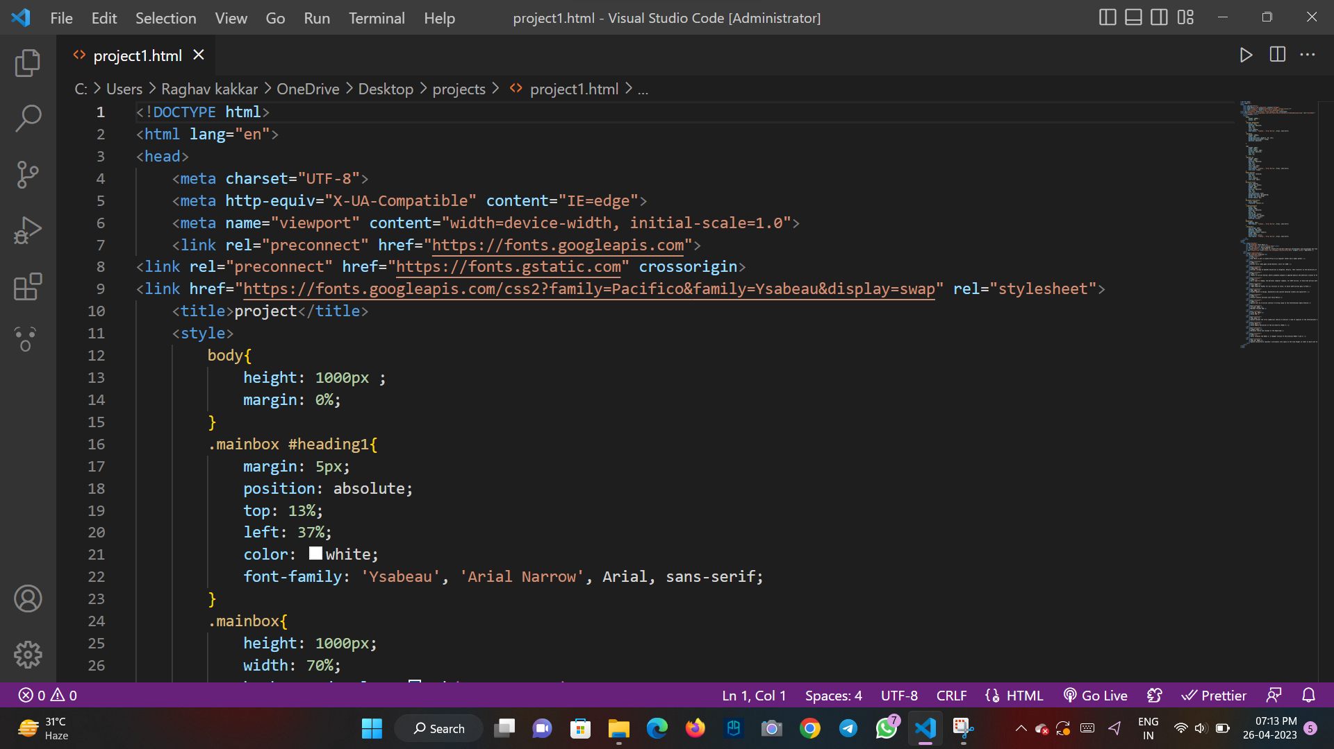
Project Highlights
Given below are some snippets of the HTML and CSS codes :-

Slide 8
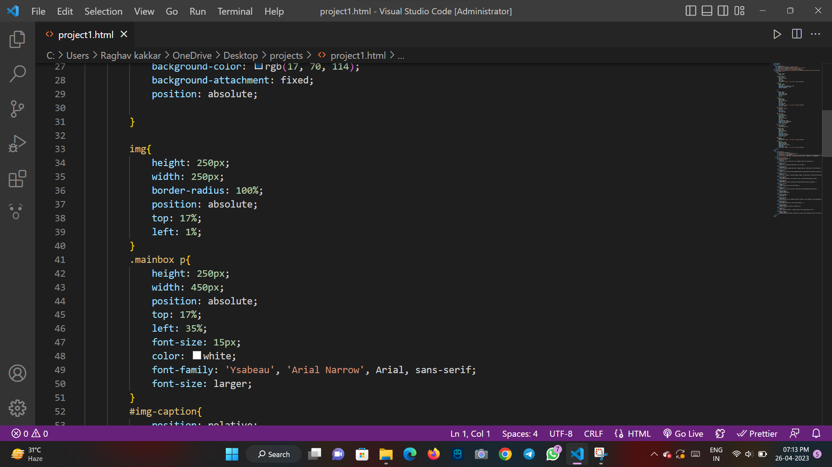

Slide 9
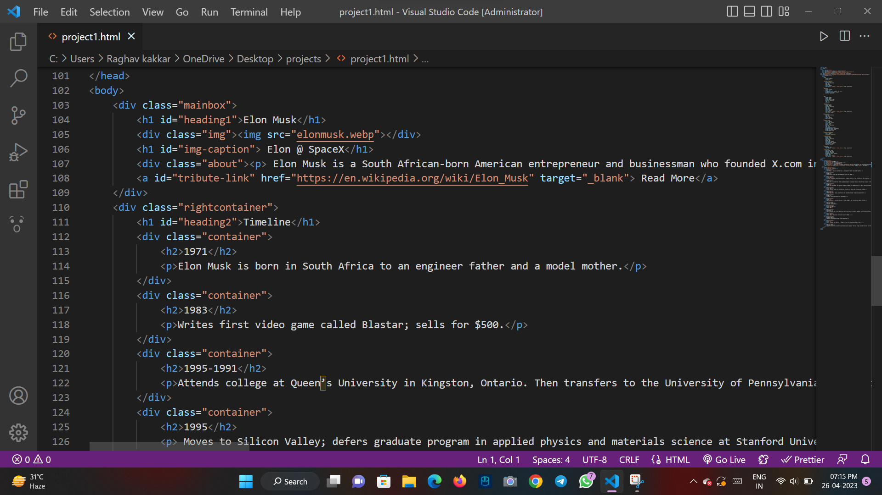

Slide 10
Conclusion
The main conclusion drawn from the project is:-
1. Commemoration and Preservation
2. Awareness and Education
3. Emotional Connection and Healing

Slide 11
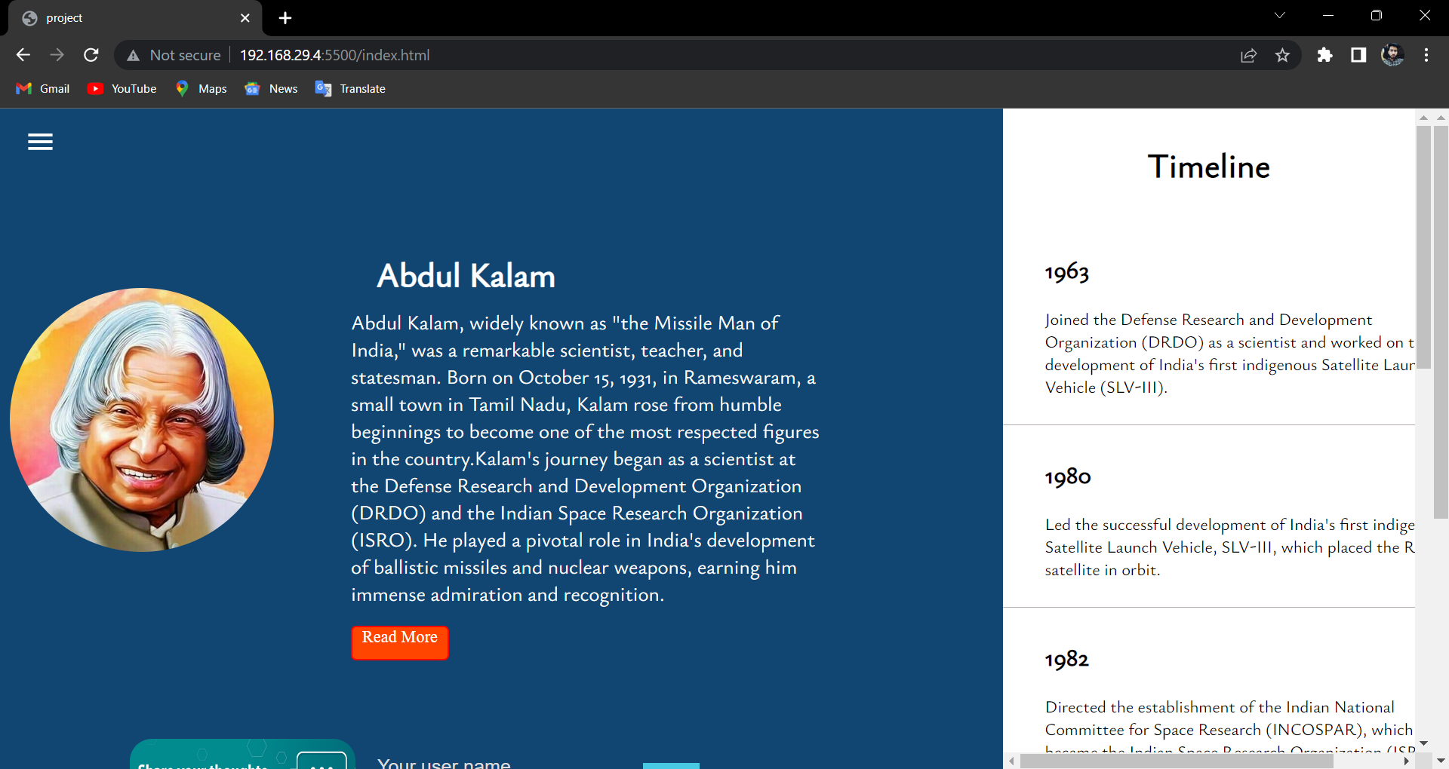
OUTPUT

Slide 12
References/Links used
Youtube
www.w3 schools.com
wikipedia

Slide 13


